Slide 1

Our Goal
Dream Big – set goals –take actions

Slide 2
Preparation.split();
justify-content-start
Interview
justify-content-center
Internship
justify-content-end
Project

Slide 3
Interview
Web Developer
Front End Developer
Backend Developer
Wordpress Developer
Full Stack Developer

Slide 4
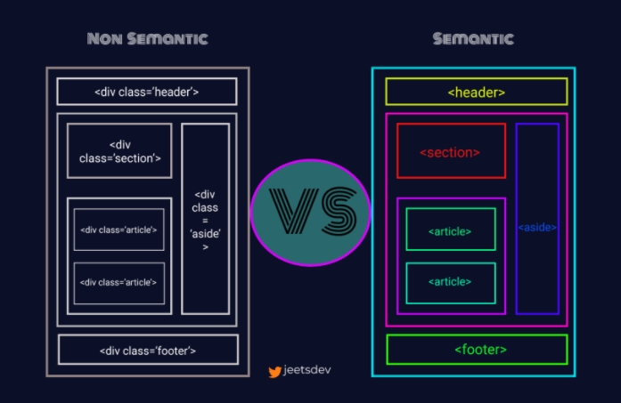
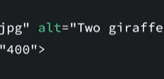
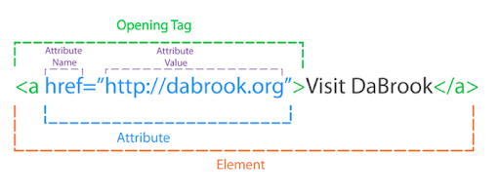
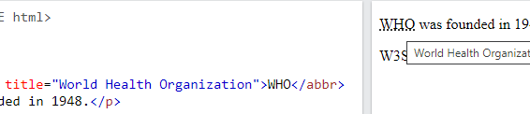
Frontend developer
Needed skills
HTML
CSS
Javascript
Beginner: -Basic Tags & Attributes
Intermediate: -Writing Semantic HTML
Advanced
-Basic SEO
-Accessibility

Slide 5

Frontend developer
Needed skills
HTML
CSS
Javascript
Beginner: -Basics styling
-Creating Layouts -Basic CSS3
Intermediate: -Responsive Layouts using media Queries -Advanced CSS3
-Good understanding of float, positioning, display property and box model.

Slide 6
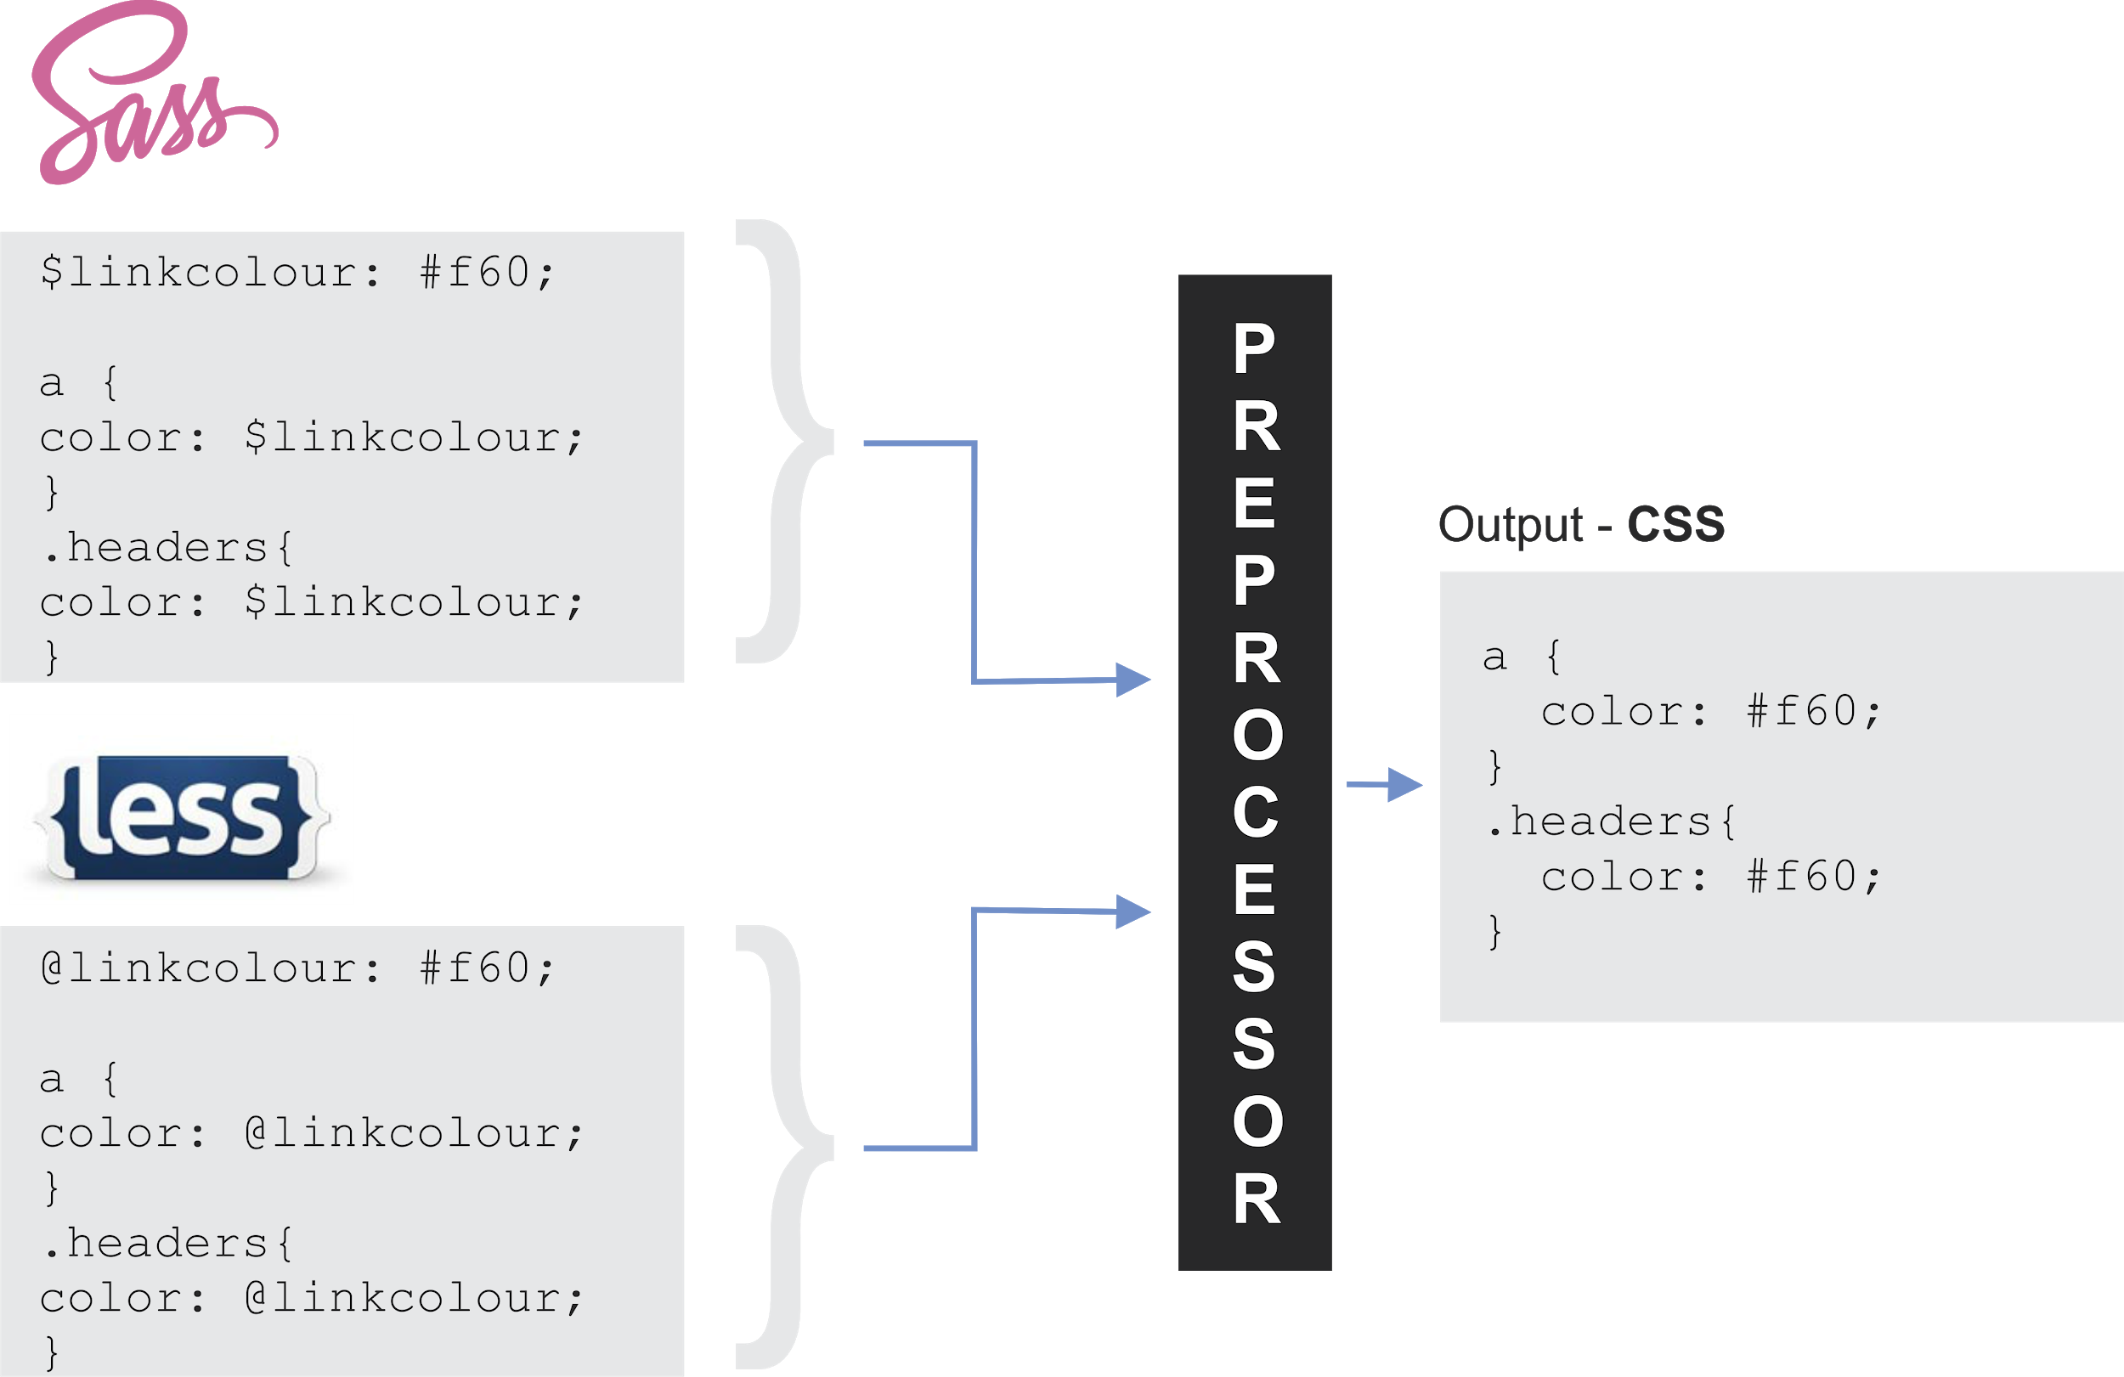
Frontend developer
Needed skills
HTML
CSS
Javascript
Advanced: - CSS FlexBox - CSS Grid - SASS or LESS
-Bootstrap or Materialize or Semantic UI
Goku level: - CSS Architecture BEM or OOCSS or SMACSS

Slide 7
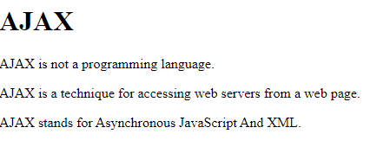

Frontend developer
Needed skills
HTML
CSS
Javascript
Beginner: -Basic language constructs
-Basic DOM manipulation
-Basic Ajax
Intermediate: -Reference Types
-Primitive wrapper objects
-ES6 and Beyond

Slide 8
Frontend developer
Needed skills
HTML
CSS
Javascript
Advanced: -Hoisting, Scope
-Prototypal inheritance
-Exection stack and context
-Event Bubbling, Event loop, Strict mode

Slide 9
Frontend developer
Improvement
Work flow
Task Runners: Gulp, npm scripts
Code Lint and format: Prettier, EsLint Module Bundler: Webpack, Parcel, Browserify, Rollup

Slide 10

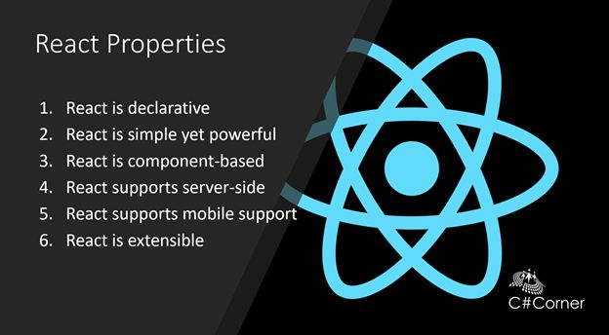

Frontend developer
Frameworks
Jquery
React JS
Angular JS
Vue JS

Slide 11
Frontend developer
Advanced
State Management: Redux, Mobx
Testing: Jest, Enzyme, Cypress, Mocha, chai
Server side Rendering: next.js after.js, etc
Static site Generator: Gatsby js

Slide 12
Mobile development
React Native
Native script
Iconic Framework

Slide 13
Desktop Development
Electron
Proton Native
Carlo

Slide 14




Backend Developer
Skip
Learn a language => Package management,
Standards, best practices and testing
Php => composer => psr => PSR
Javascript =>node js =>npm and yarn =>Eslint
Python => pip => pep88
Ruby => Gems => Ruby style Guide
Learn relational database and NoSQL DB
Learn Caching, RESTful APIs, Authentication
And more…

Slide 15
Wordpress Developer
Skip
HTML, CSS, Javascript, PHP and MySQL
Theme development
Plugin development

Slide 16
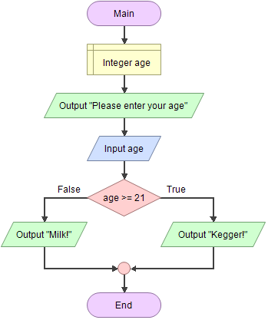
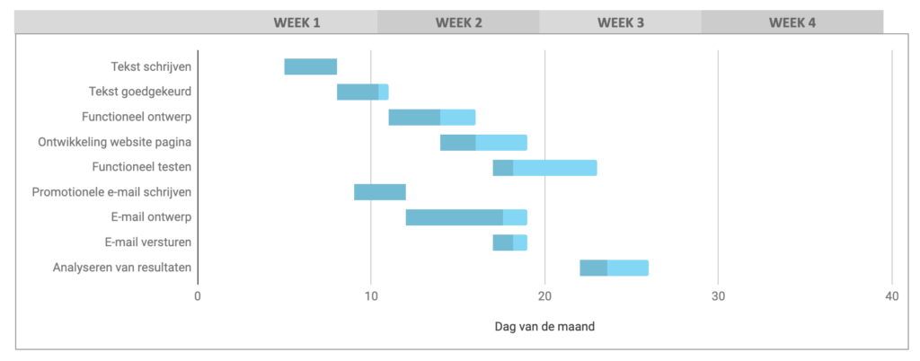
Internship
tools
Flowchart
Gantt chart

Slide 17

Project
OTT platform
OTT – platforms
Portfolio
After finishing javascript – end november
Anyone interested?
THANK YOU

